Slide 1
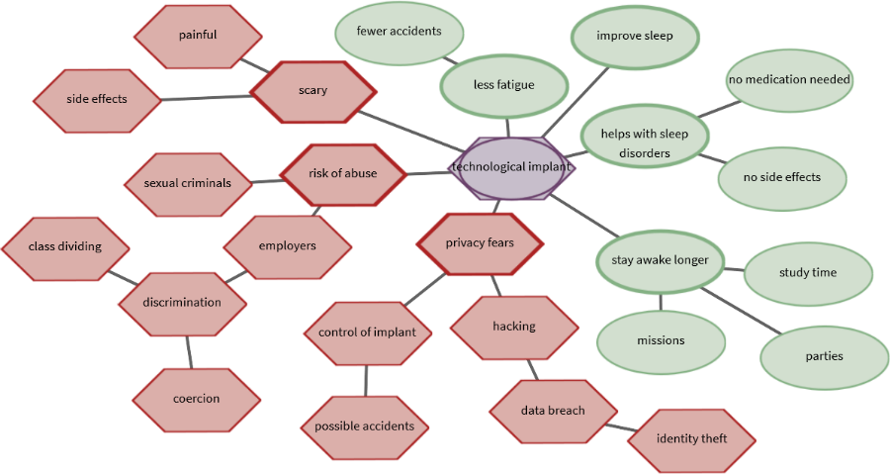
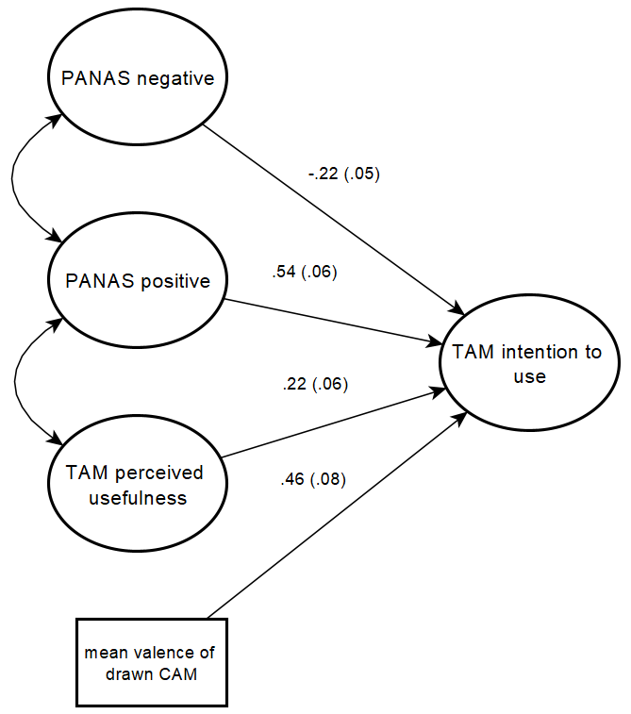

Predicting technology acceptance using CAMs
Use of a technology can be predicted according to the technology acceptance model (Venkatesh & Bala 2008). Thereby, questionnaires assess previously known influencing variables. To identify further influential factors on technology acceptance so called "Cognitive Affective Maps" (CAMs) can be applied (e.g. Livanec et al. 2020). CAMs are a quantitative and qualitative research tool to identify, visually represent and analyze existing belief structures or attitudes.
Figure 1. CAM drawn by a participant concerning the acceptance of a fictional nanoimplant.
Only recently have CAMs been increasingly researched quantitatively (e.g. Reuter et al. 2021), and currently I am working on an R package to quantitatively analyze these kinds of networks (e.g. aggregating CAMs, computing complex network indicators, splitting CAMs in components).
Pilot study
central hypothesis (which will result in a publication after replication with a larger sample size):
Can CAM data provide additional information to questionnaires and thus have an additional predictive value?
Participants (N=90) answered questionnaire scales and drew a CAM regarding a scenario text
Treatment: participants were presented a CAM with the opposite affective connotation to their previously CAM; Control group without treatment
Preliminary data analyses
Hypothesis 1. Using structural equation models it is possible to structurally analyze the acceptance process of a fictional technology. To account for the non-normal distribution of the questionnaire items and the small sample, the DWLS estimator was used and the $X^{2}$ statistic adjusted (e.g. Hancock & Mueller 2013). As a preliminary result, there is a highly significant influence of the mean valence of the drawn CAM.
Figure 2. Predicting intention to use the nanoimplant
Future Research Plans
Run a Monte Carlo study to decide on sample size and determine power
Systematically analyze CAM and questionnaire data for at least three studies (one already collected) using different outcome variables and including additional structural network indicators
Identifying clusters of similar CAMs using similarity algorithms and compare this clusters with latent classes within questionnaire identified by Latent Class Analysis
Hancock, G. R., & Mueller, R. O. (Eds.). (2013). Structural equation modeling: A second course. IAP.
Lischetzke, T., Reis, D., & Arndt, C. (2015). Data‐analytic strategies for examining the effectiveness of daily interventions. Journal of Occupational and Organizational Psychology, 88(3), 587-622.
Livanec S., Stumpf, M., Reuter L., Fenn J. & Kiesel A. (2021). Who’s gonna use this? Psychological acceptance prediction of emerging technologies and transdisciplinary considerations in the Anthropocene. Manuscript submitted for publication.
Reuter, L., Fenn, J., Bilo, T. A., Schulz, M., Weyland, A. L., Kiesel, A., & Thomaschke, R. (2021). Leisure walks modulate the cognitive and affective representation of the corona pandemic: Employing Cognitive‐Affective Maps within a randomized experimental design. Applied Psychology: Health and Well‐Being.
Venkatesh, V., & Bala, H. (2008). Technology acceptance model 3 and a research agenda on interventions. Decision sciences, 39(2), 273-315.
Exploring cognitive affective maps as a new mode of data collection
Julius Fenn, University of Freiburg
Notes:
2-column design for graphic-heavy posters
Adjust font sizes to fit Title & Authors in one line each (but no smaller than 12pt!)
IMPORTANT: This template uses the font "Lora" for titles (it is also used in the SMiP logo). You can download (and then install) the font from
https://fonts.google.com/specimen/Lora
(it is licensed under the SIL Open Font License (cf. http://scripts.sil.org/OFL) which means you can use it freely (except for commercial purposes))

